Slide 1
The Starting Point
Notes:
RC-2000
RC-2020
RC stands for Renewal and Change but …. Not a lot of people know that!
The mission or core purpose is renewal and change and as our Bylaws state, we do this by exchanging CEO views and college practices in an open, honest and candid manner.
RENEWAL and CHANGE – reflects our commitment to constantly challenge and improve services and utilize partnerships to better serve their students, faculty and communities.

Slide 2
Why change?
Notes:
2020 is just around the corner.
There is little to no brand recognition
Anecdotal feedback suggests that the RC brand is viewed as an ‘old boys network’ – a closed shop for boys.
We know that this is not the case.
Also, we’re at a cross roads.
Founding members are retiring and we need to ensure that the brand is relevant and accessible.

Slide 3
It’s just another Leadership Network…..
Notes:
Unique, safe space to share high points and low points
There’s gravitas – huge experience in the room
No competition – genuinely collegiate learning environment.

Slide 4
IMO RC-2020 is different because of the members’ values….
“
People who end up as ‘first’ don’t actually set out to be first.
They set out to do something they love….
Condoleeza Rice
Notes:
The student comes first every time.
It’s personal – you all want every student to succeed.
Humility/humble
This is your vocation…..

Slide 5
What makes RC-2020 standout from the leadership networking crowd?
Notes:
Elite
Global
Invitation

Slide 6
What the Future could look like
Notes:
At a crossroads?
Founding Presidents have retired. Stalwart members are retiring.
Time to thrive or die.
Needed to start a brand conversation….

Slide 7
Initial Brand conversation

Slide 8
What’s in a Name?
Notes:
RC-2020 is so subtle that I have to explain it every time.
It gives nothing away about who we are, what we do.
It makes no connection to the sector, the mission or the values of the network?

Slide 9
Notes:
1. At our conversation in Miami, we felt it was really important to have ‘community college’ in the name.

Slide 10
Firm Belief
Faith
Honest
Confidence in the certainty
Notes:
We wanted the name to reflect the relationships between the members and the term that came up time and again was ‘Trust’

Slide 11
Uniting a Nation
Giving life chances
Stronger, Together
Making possible
Better opportunities
Guiding light
Future proofing
Empowering
Notes:
We also looked at how the brand would work in campaign format.
Asked ourselves the question – ‘why do CC’s exist’ and the response was ‘we exist for generations’

Slide 12
Honesty
Stable
Extravagance
Wisdom
Professionalism Formality
Power
Sophistication
Notes:
We looked at a colour palette that resonated with the brand:
Copper that implies honesty and stability
Gold that implies wisdom
Silver that infers professionalism and
Black that reinforces power and sophistication.

Slide 13
Notes:
We put this together to come up with the first proposal.

Slide 14
Notes:
And then we started to look at how this would work across various formats….
On a brochure

Slide 15
Notes:
On a poster….

Slide 16
The conversation continued
Notes:
We shared the first iteration in Oklahoma and the feedback included:
For our Generations doesn’t reflect the shared values of the members. It needs to be more personal and it needs to be aspirational.

Slide 17
Notes:
We shared the first iteration in Oklahoma and the feedback included:
For our Generations doesn’t reflect the shared values of the members. It needs to be more personal and it needs to be aspirational.

Slide 18
Notes:
Community College and Trust in the name is very important but, we need reference to the Global nature of the membership.

Slide 19
Notes:
The black colour way was too corporate but we still needed a colour that reflects the gravitas and heritage of the organization.

Slide 20
Notes:
Tested the concept to see how it work across campaigns and how it would translate across materials.

Slide 21
Notes:
Outdoor advertising

Slide 22
Notes:
Building the urban landscape into the creative

Slide 24
Notes:
Examples of a potential membership recruitment campaigns

Slide 26
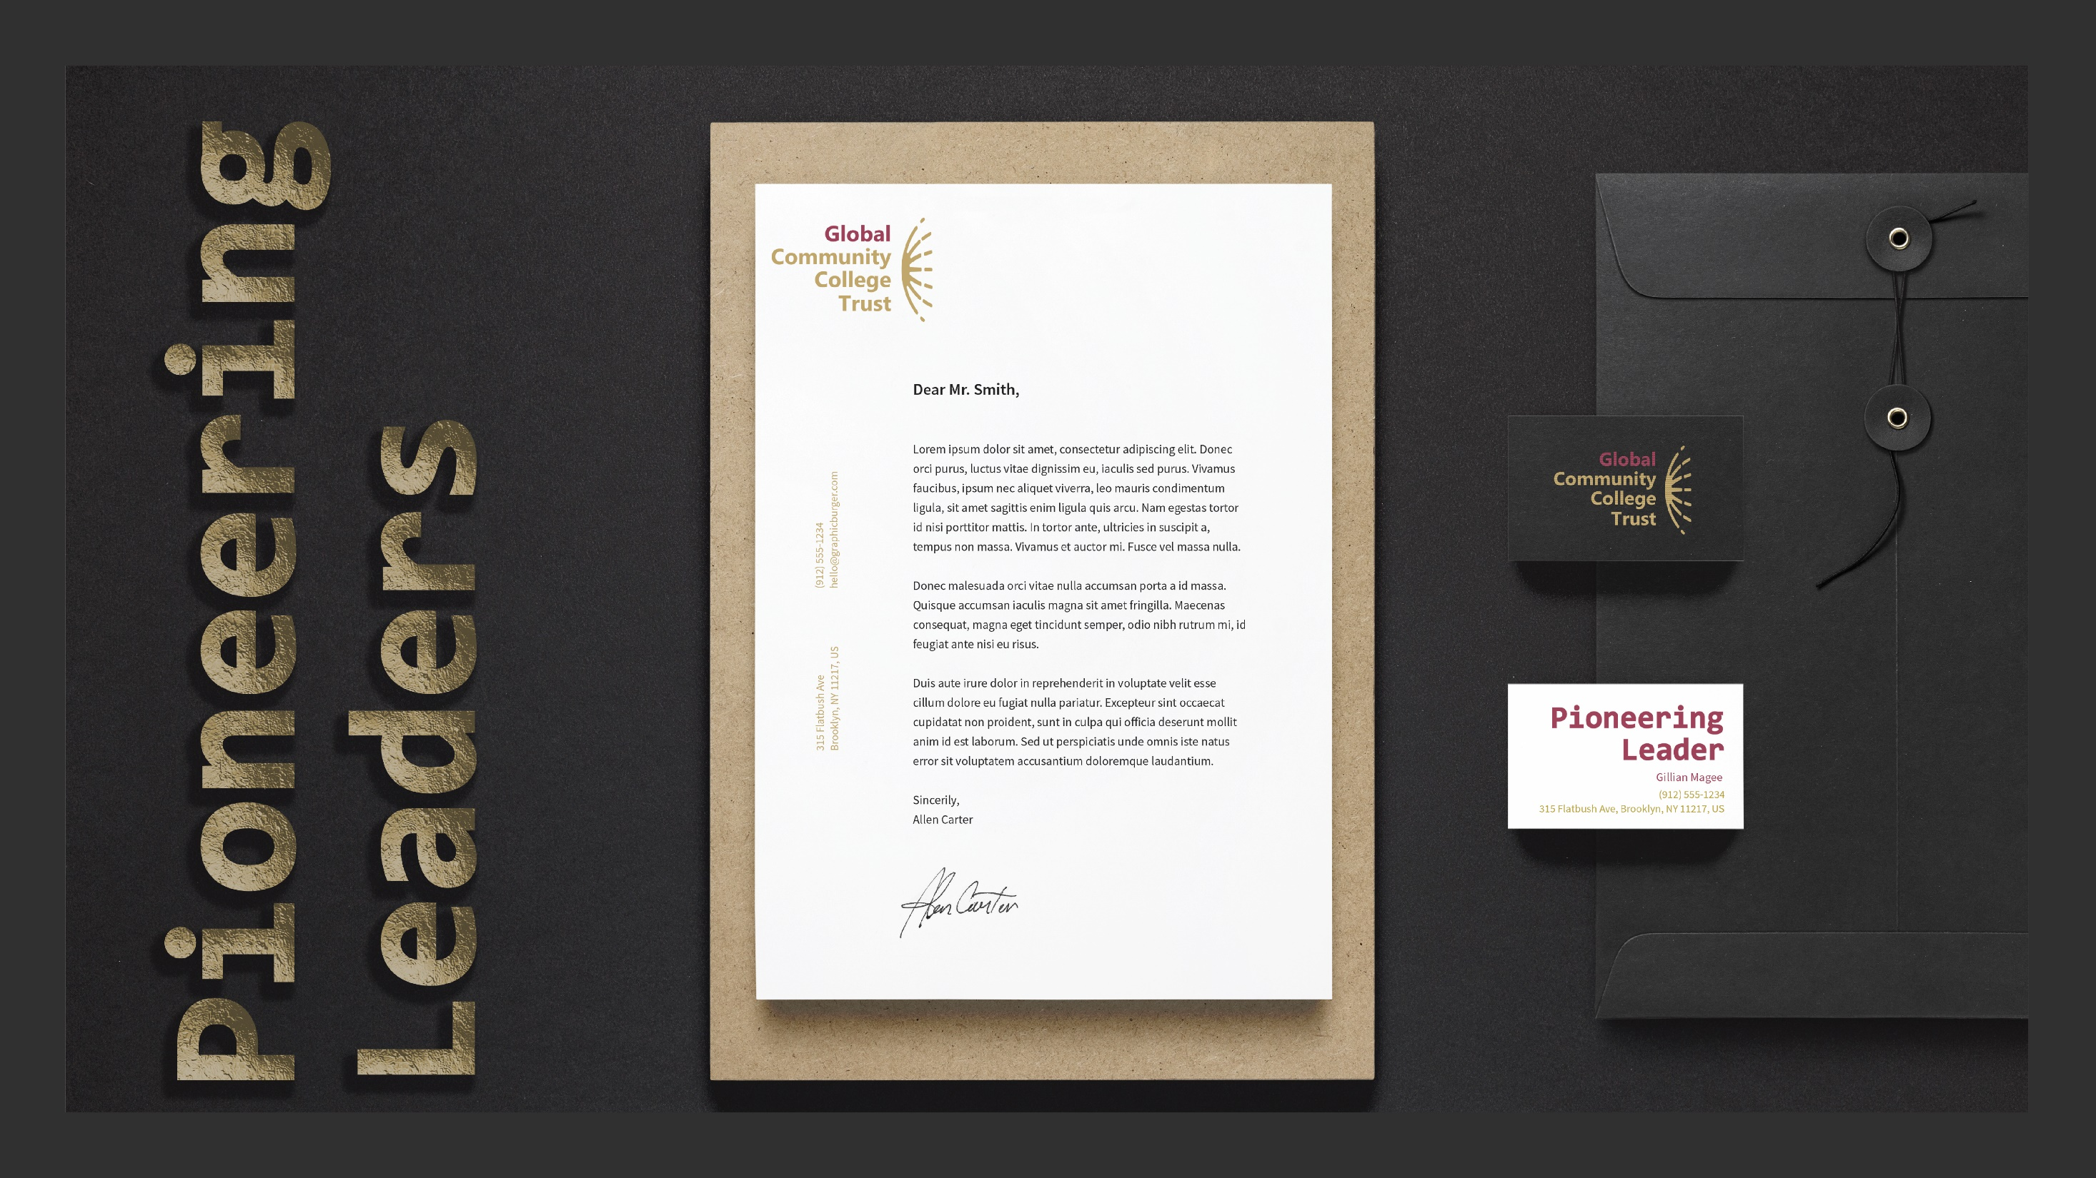
Notes:
Examples of corporate collateral

Slide 27
Observations Next steps

